Slide 1
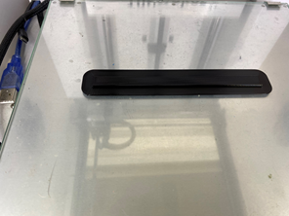
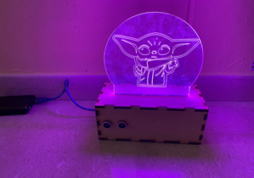
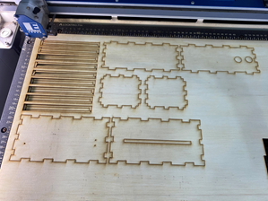
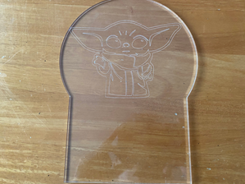
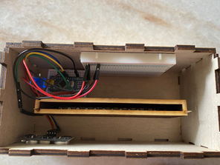
Mood Lamp with light changing function
Laser cut : Box casing with Acrylic support and Acrylic
3D Print : Neopixel support
This is a simple Mood Lamp the purpose of the Mood Lamp is to illuminate the area of the house.
Neopixel and Ultrasonic Sensor Wiring
Input: Ultrasonic Distance Sensor
Output : Neopixel LEDs
How It works : By putting your hands near the ultrasonic distance sensor it will automatically change the light from neopixel.
Ng Jun Jie DMB
EP1000
Semester 1, 2021

